Slide 1
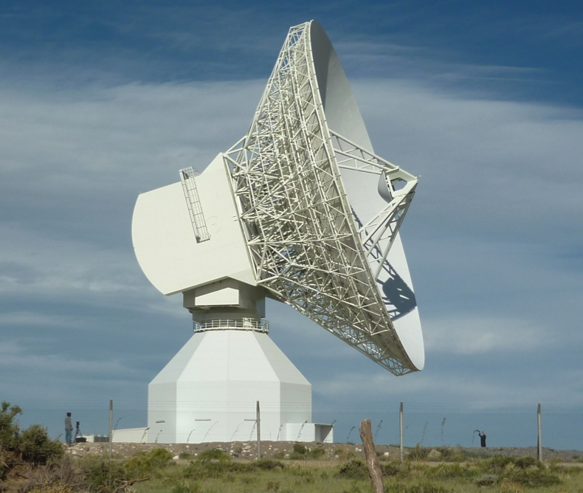
The X/Ka Celestial Reference Frame:
towards a GAIA frame tie
Cristina García Miró
Madrid Deep Space Communications Complex NASA, ISDEFE, Spain
C.S. Jacobs, S. Horiuchi, J.E. Clark, R. Madde, M. Mercolino, D. Pazos,
C.J. Naudet, L. Snedeker, G. Bourda, P. Charlot, I. Sotuela, L.A. White
EVN Symposium October 2014, Cagliari

Slide 2
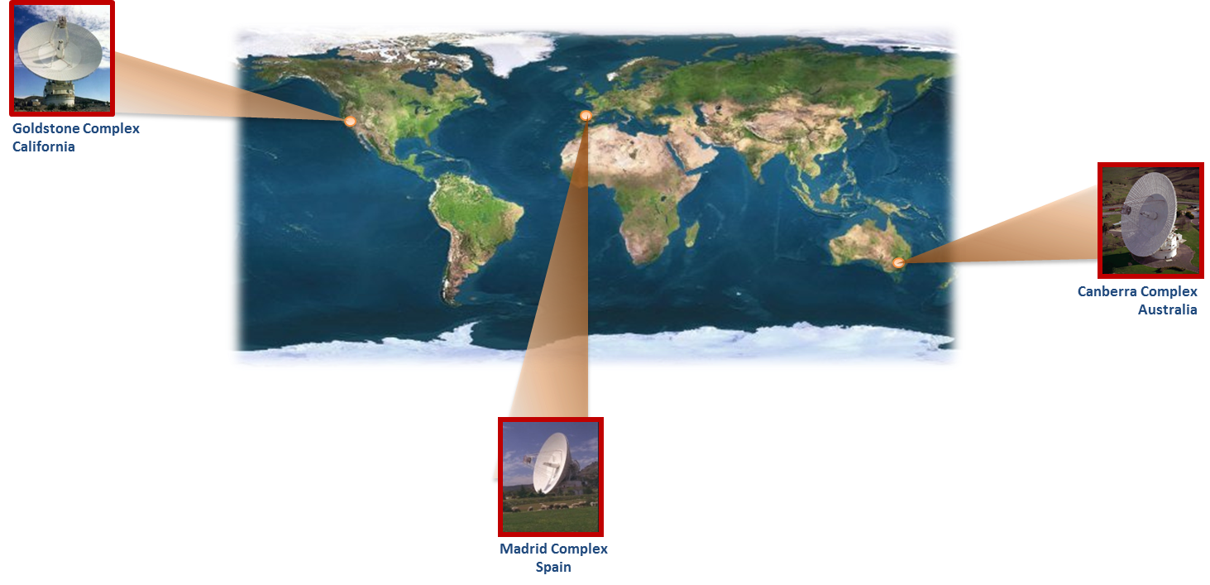
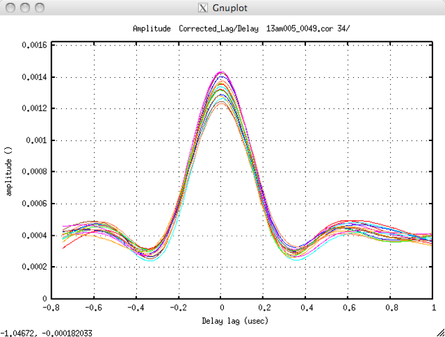
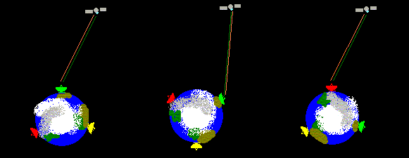
Celebrating 50 years of the NASA’s Deep Space Network
Extended Ka-band DSN!!
Malargüe ESA antenna
Since early 2013

Slide 3
Overview
• Nature of astrometric targets: why Ka-band (32GHz)?
better point-like sources at VLBI scales
• X/Ka Celestial Reference Frame:
Southern Geometry improvement: NASA-ESA collaboration to use ESA’s X/Ka 35-meter antenna in Malargüe, Argentina
South Polar Cap results: 138/144 candidates detected! 96% success rate! 26 ICRF-2 defining sources detected
X/Ka in the context of ICRF-2 Celestial Frame:
100 sessions, 35K group delay/phase rate observations
Declination bias reduced by factor of three!
• Optical frames: tying to ESA’s Gaia mission optical frame
X/Ka observations of GAIA tie sources from Bordeaux Laboratoire d’Astrophysique (GAIA CU3, Bourda et al. 2008, 2010, 2011)
18 GAIA tie sources detected in Ka
Simulated X/Ka frame tie precision of ~ 7 µas per 3-D rotation angle

Slide 4
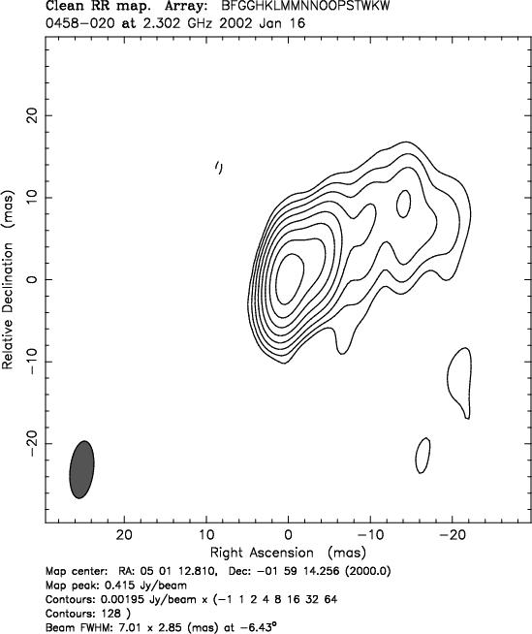
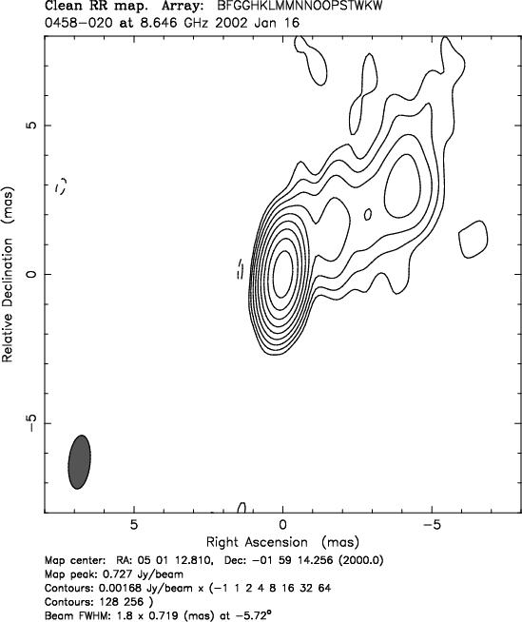
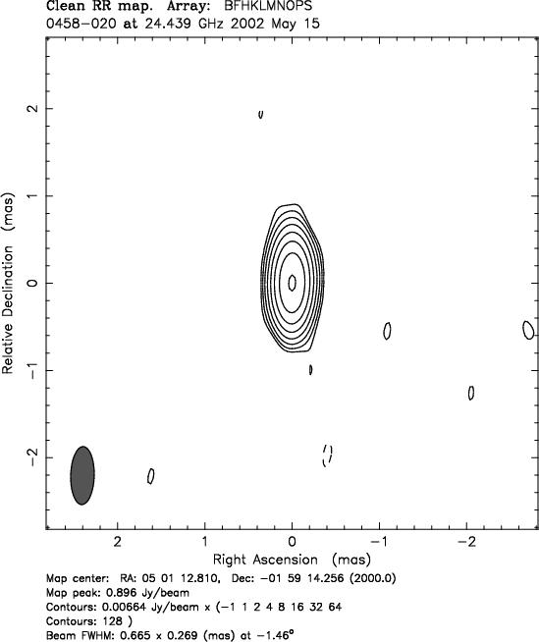
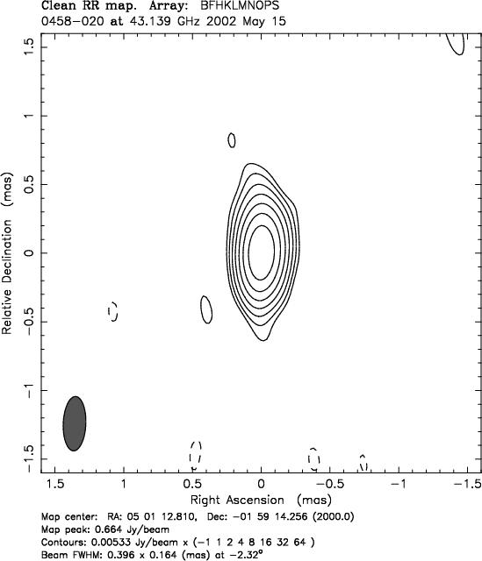
Source structure vs. wavelength
S-band X-band K-band Q-band
2.3 GHz 8.6 GHz 24 GHz 43 GHz
13.6cm 3.6cm 1.2cm 0.7cm
The sources
become better →
smaller structure indexes
(Fey & Charlot 1997)
Ka-band
32 GHz
0.9cm
Images credit: P. Charlot et al, AJ, 139, 2010

Slide 5
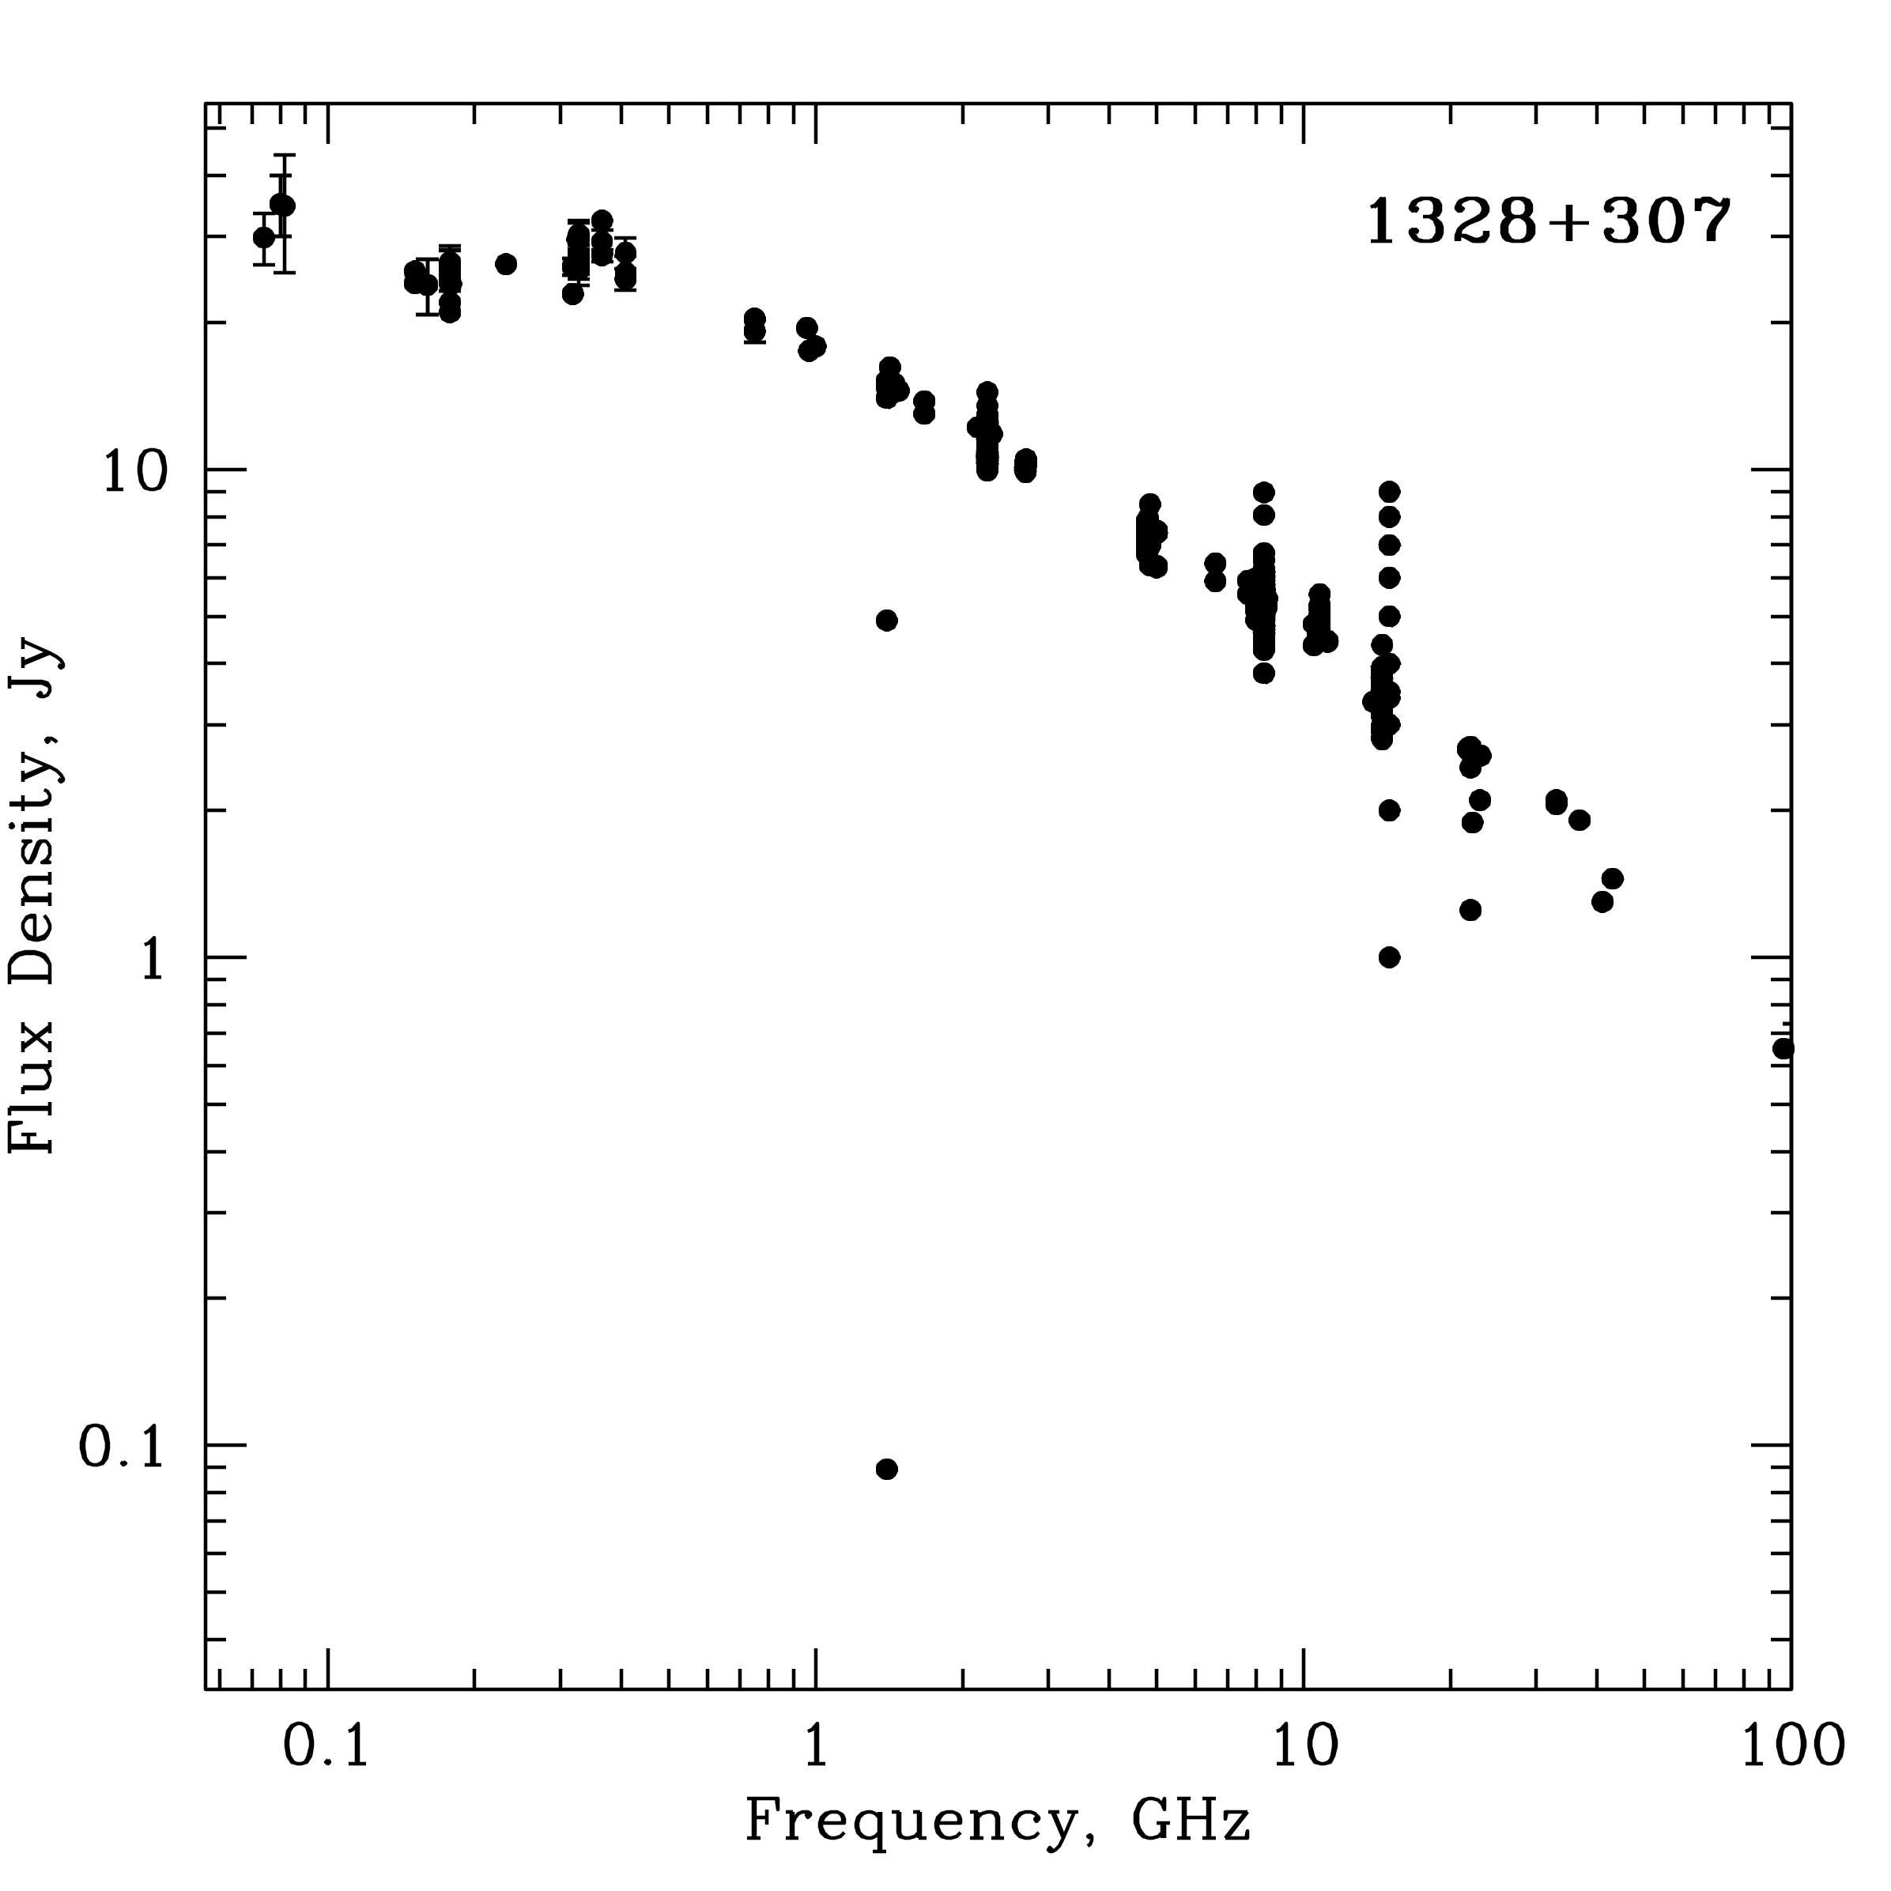
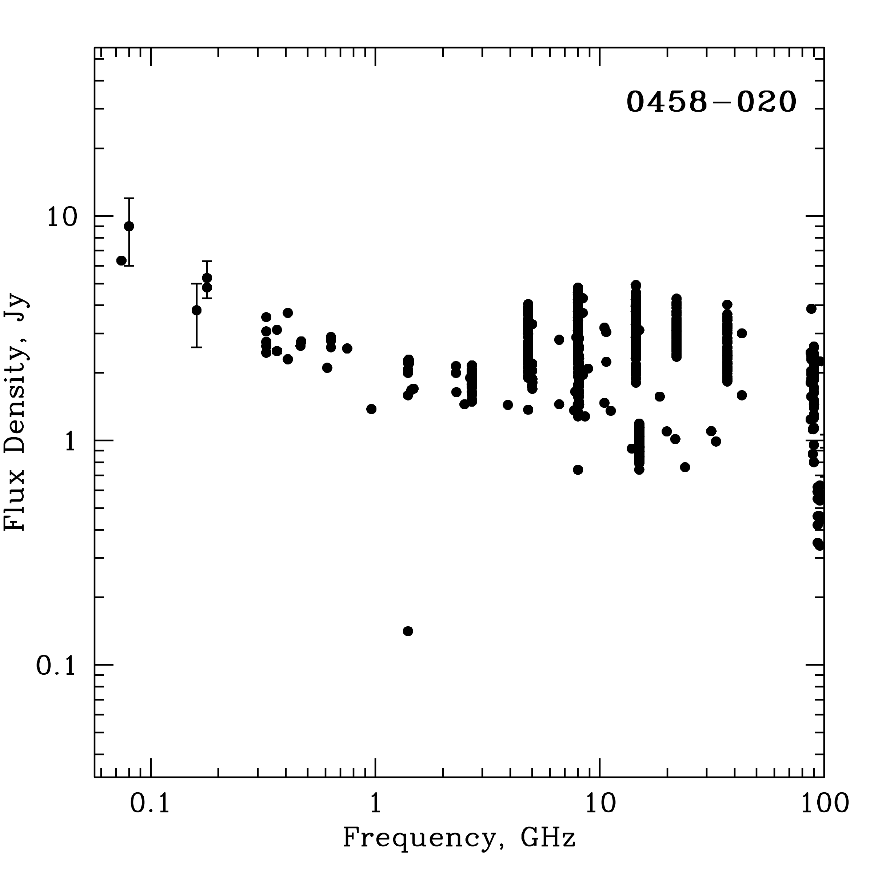
Source emission vs. wavelength
Typical source emission:
Generally emission decreases with frequency
(steep spectrum), but not for all sources!
and variable with time, but not for all sources!
Multiepoch radio spectrum
3C286
Ka-band
32 GHz
0.9cm
Ka-band
32 GHz
0.9cm
Images credit: MOJAVE project, Lister et al, AJ, 137, 2009

Slide 6
Astrometric sources at Ka-band
• Quasar astrophysics gets better for astrometry:
Sources more compact at shorter wavelength (higher frequency)
More sources resolved at higher frequency → less sources
Fainter sources at higher frequency
Less extended structure: plume is steep spectrum
Core shift (Synchrotron self absorption opacity) reduced at short wavelength/high frequency

Slide 7
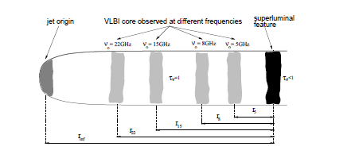
Astrometric sources at Ka-band
• Quasar astrophysics gets better for astrometry:
Sources more compact at shorter wavelength (higher frequency)
More sources resolved at higher frequency → less sources
Fainter sources at higher frequency
Less extended structure: plume is steep spectrum
Core shift (Synchrotron self absorption opacity) reduced at short wavelength/high frequency → Optical to S/X core shift ~100 µas in phase delay, smaller at X/Ka ~25 µas
For typical equipartition conditions
the astrometric group delays measure
the position of the jet base independent
of core shift effects vs. frequency
(Porcas, A&A, 505, 1, 2009)
Images credit: Lobanov 1996; Kovalev , A&A, 483, 2008

Slide 8
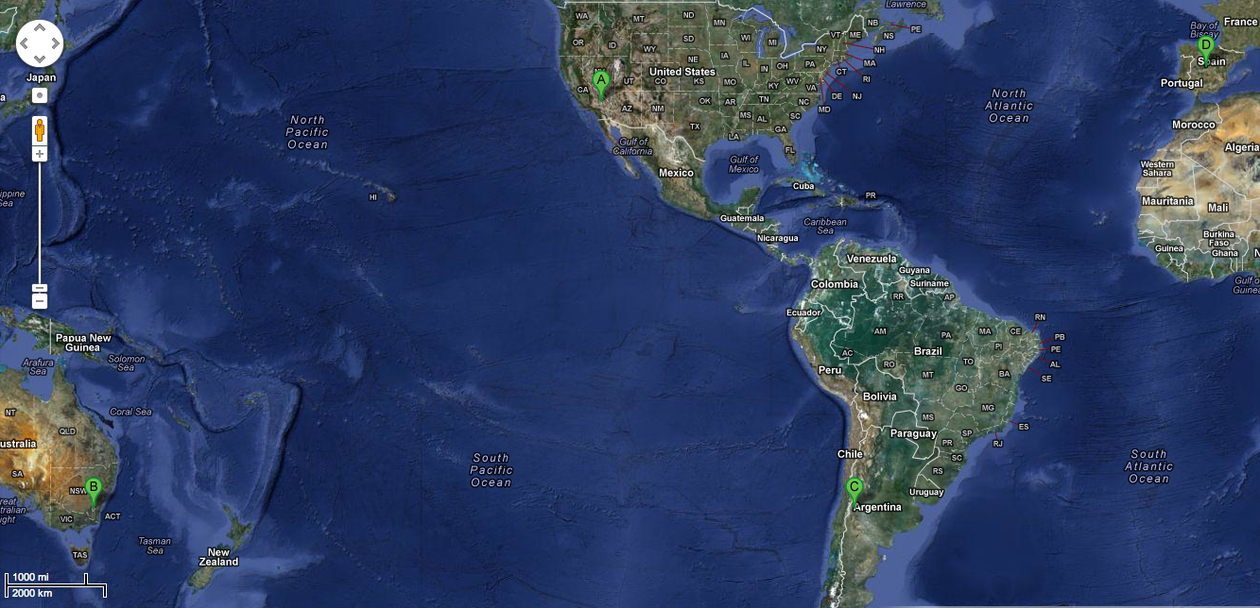
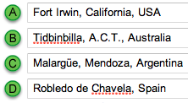
X/Ka Celestial Reference Frame
8400 km
9900 km
10,600 km
8500 km
9810 km
Maps credit: Google maps
ESA’s Argentina 35-meter antenna adds 3 baselines to DSN’s 2 baselines
• Full sky coverage by accessing south polar cap
• near perpendicular mid-latitude baselines: CA to Aust./Argentina

Slide 9
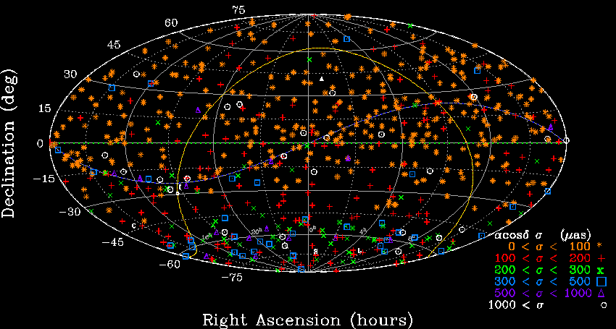
NASA-ESA 32GHz RA results: 654 sources
DSN: Goldstone to Madrid & Canberra
+ ESA baselines: Malargüe to Canberra, Goldstone, Madrid
100 sessions, 35K group delay/phase rate observations
Petrov catalog: aprox. 450 bright sources >200mJy, 70% unresolved flux

Slide 10
NASA-ESA 32GHz DEC results: 654 sources
Goldstone to Madrid & Australia + Malargüe to Canberra,Goldstone, Madrid.
138 sources in south cap (dec<-45); 26 ICRF2 Defining; 2/3 of south cap non-ICRF2

Slide 11
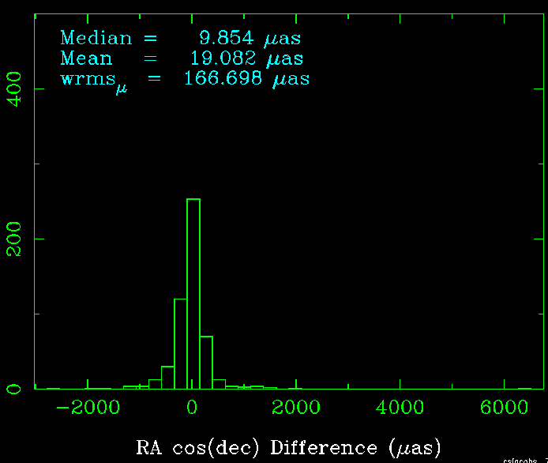
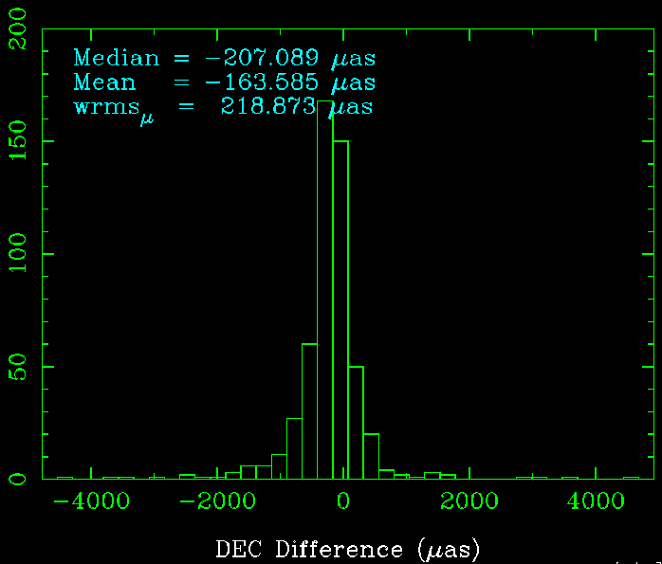
XKa vs. SX ICRF2: 525 sources
wRMS(α cosδ ) = 167 μas
wRMS(δ) = 219 μas

Slide 12
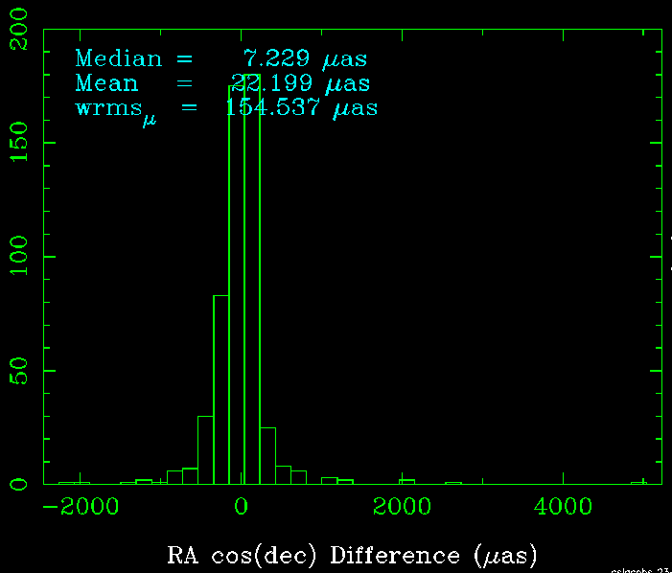
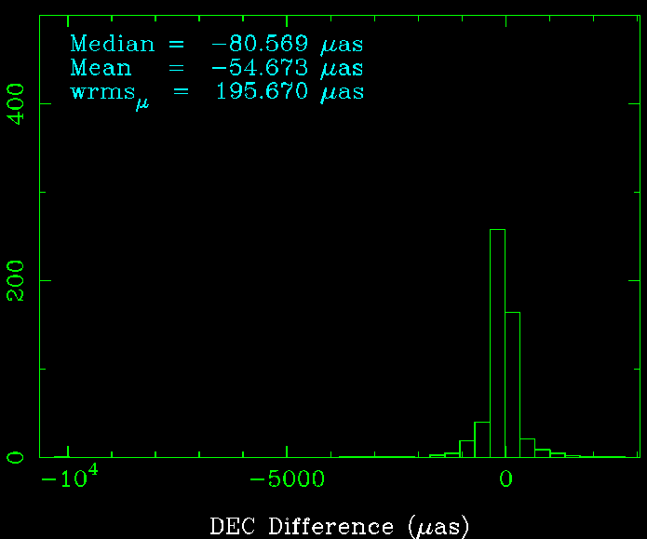
XKa vs. SX ICRF2 improved: 535 sources
wRMS(α cosδ ) = 154 μas
wRMS(δ) = 196 μas
Mean offset reduced by 3X relative
to GSFC-2014bp3! -164 -> -55 µas
GSFC-2104bp3: credit Gordon et al, private communication, NASA Goddard, 2014

Slide 13
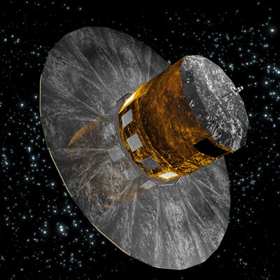
ESA’s GAIA mission
Gaia: 10⁹ stars • 500,000 quasars V< 20 mag 20,000 quasars V< 18 mag • radio loud 30-300+ mJy and optically bright: V<18 mag ~2000 quasars (Mignard, Journees, 2013)
Quasar Precision 70 µas @ V=18 25 µas @ V=16
Figure credit:
http://www.esa.int/esaSC/120377_index_1_m.html#subhead7

Slide 14
ESA’s GAIA mission
Gaia: 10⁹ stars • 500,000 quasars V< 20 mag 20,000 quasars V< 18 mag • radio loud 30-300+ mJy and optically bright: V<18 mag ~2000 quasars (Mignard, Journees, 2013)
Quasar Precision 70 µas @ V=18 25 µas @ V=16
Figure credit:
http://www.esa.int/esaSC/120377_index_1_m.html#subhead7
Launched 19 Dec 2013!!
Several issues on GAIA performance could affect V>=18
First Notional Intermediate catalog L+22m (pos) → mid-2016

Slide 15
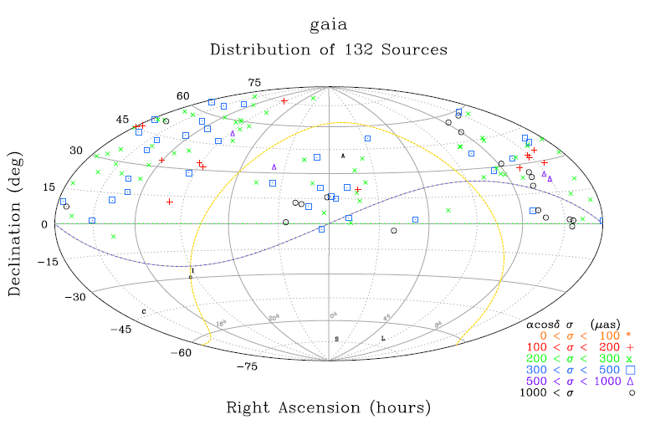
Tying to GAIA’s optical frame
• Only 6% ICRF2 sources (195) good for GAIA frame tie (V<=18 and compact), Bourda et al 2012.
• Additional “GAIA tie sources (119)” selected from 447 optically bright (V<=18) extragalactic radio sources from NVSS (20x weaker than ICRF). 89% detection rate with EVN, 50% point-like on VLBI scales. Bourda et al 2010, 2011, 2014 in preparation.
• “GAIA tie sources” included in
DSN S/X catalog, 132 new
detections, mostly Northern
Hemisphere.
•Selected strongest flat
spectrum sources for X/Ka:
detected 18 new sources
Gaia
Distribution of 119 Sources

Slide 16
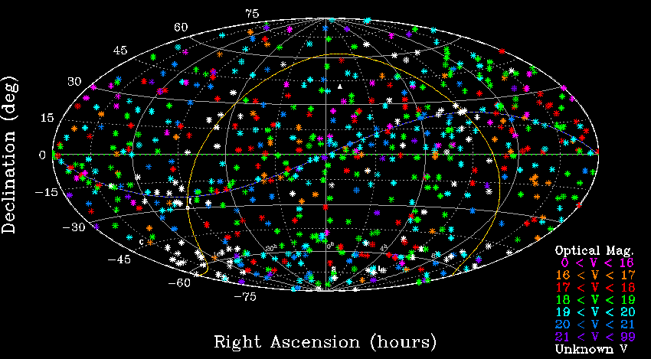
Tying X/Ka to GAIA’s optical frame
XKa: 175+ optically bright counter parts: V< 18mag
(optical V magnitudes: Veron-Cetty & Veron, 2010)
X/Ka frame tie: measured XKa precision and simulated Gaia optical precision yields frame tie alignment precision of ~ 7 µas per 3-D rotation angle

Slide 17
X/Ka-FERMI gamma-ray correspondence
X/Ka sources (blue) which are surrounded by red squares are also in the
Fermi 2FGL gamma-ray point source catalog. Over 1/3 of X/Ka sources
(~175) have gamma-ray detections.
Credit: Majid et al, IVS, Madrid Spain, 2012

Slide 18
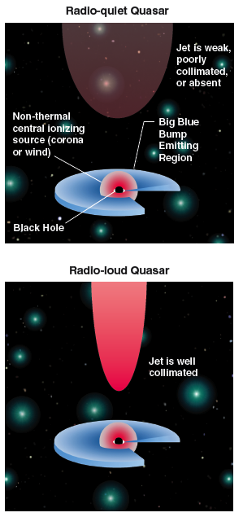
Optical vs. radio positions
Positions differences from:
• Astrophysics of emission centroids
- radio: synchrotron from jet, non symmetric
- optical from radio-loud:
synchrotron from jet dominates, axisymmetric
- optical from radio-quiet:
non-thermal ionization from corona
thermal “big blue bump” from accretion disk
- optical centroid biased by host galaxy?
(GAIA PSF ~60mas, Mignard private comm)
• Instrumental errors both radio & optical
• Analysis errors
Credit: Wehrle et al, µas Science, Socorro, 2009

Slide 19
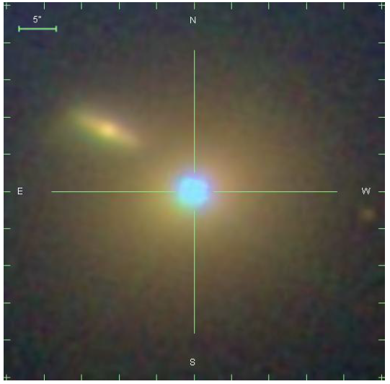
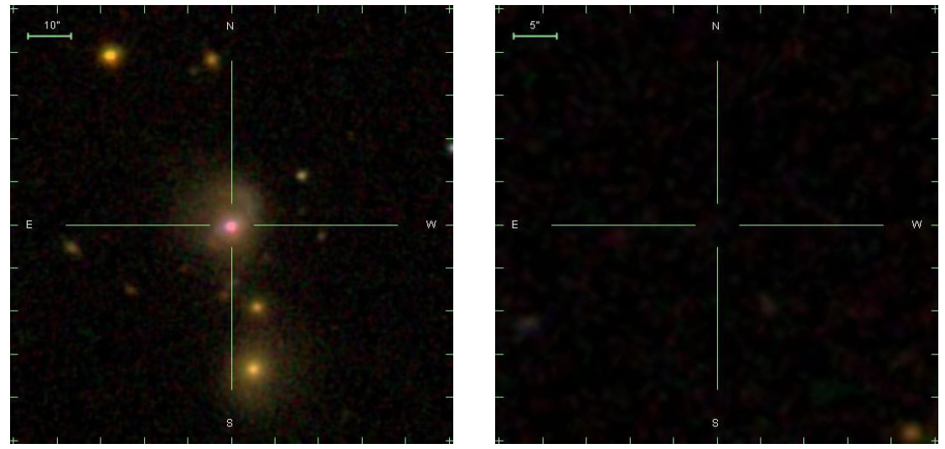
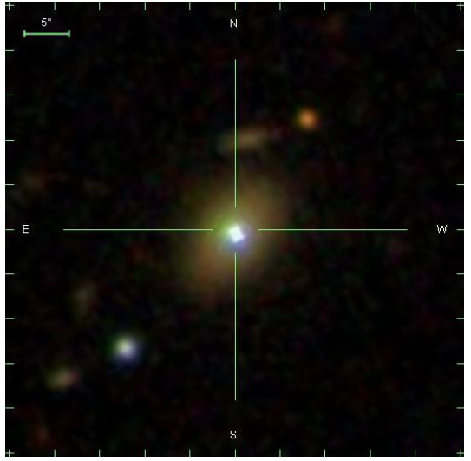
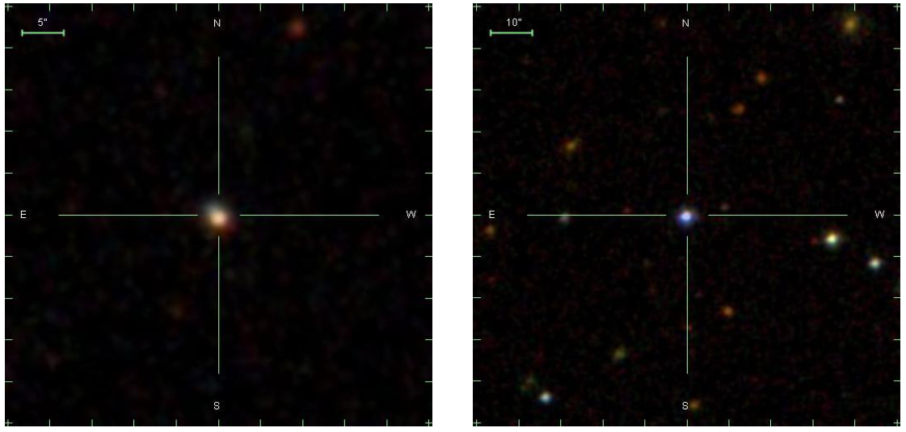
Optical centroid biased by host galaxy
Optical systematics unknown: as large as 10 mas optical centroid offset?
(Zacharias & Zacharias, AJ, 2014)
1101+384 0007+106 0920+390
1418+546 1514+192 1546+027
Credit: SDSS-9

Slide 20
Conclusions
• Increasing frequency -> lower sensitivity, but more compact
• X/Ka Celestial Frame Overview:
<200 µas 654 sources
• ESA-NASA collaboration: add Malargüe, Argentina 35-m
Improves net from 2 to 5 baselines, orthogonal mid-lat baselines
Full sky coverage by accessing south polar cap!
138 in south polar cap (dec<-45). Cap sources 2/3 non-ICRF2
26 ICRF2 defining sources detected at Ka-band in South Cap
• Optical/Radio Frames tie:
XKa VLBI/Gaia optical tie precision ~7 µas
18 GAIA tie sources detected in Ka
Research described herein partially done under contract with NASA. U.S. Government sponsorship acknowledged. Copyright ©2014. All Rights Reserved

Slide 21
The X/Ka Celestial Reference Frame:
towards a GAIA frame tie
Cristina García Miró
Madrid Deep Space Communications Complex NASA, ISDEFE, Spain
C.S. Jacobs, S. Horiuchi, J.E. Clark, R. Madde, M. Mercolino, C.J. Naudet,
L. Snedeker, G. Bourda, P. Charlot, I. Sotuela, L.A. White
EVN Symposium October 2014, Cagliari

Slide 22
Backup slides

Slide 23
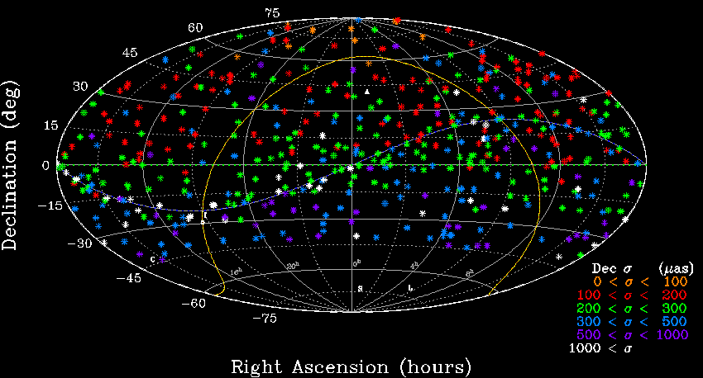
X/Ka 32GHz, Dec results: 482 Sources
Jacobs et al, ISSFD, Pasadena, 2012
Before Malargüe, Argentina: Cal. to Madrid + Cal. to Australia.
Weak in mid-south, No South Polar Cap, but No ∆Dec vs. Dec tilt
Notes:
Our X/Ka Frame is built from about 70 sessions taken with
DSN stations in California, Spain, and Australia.
We have detected 482 sources spread fairly uniformly
Over the celestial sphere north of -45 degrees Declination.
While the limited amount of data to Australia causes lower precision as one goes south,
We note that there is no systematic tilt of the X/Ka frame relative to the ICRF2.

Slide 24
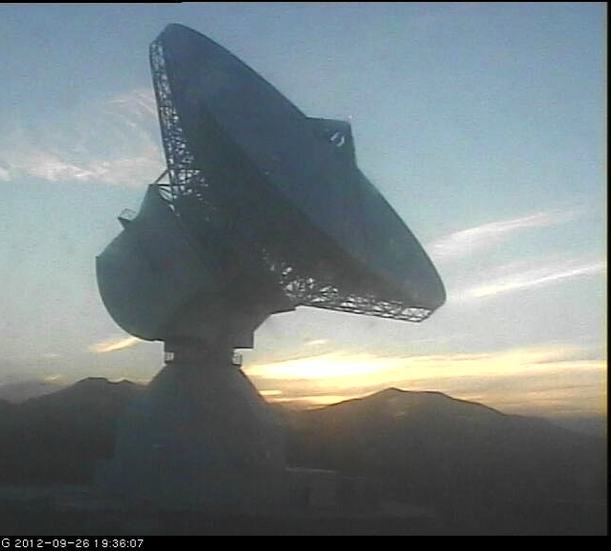
Malargüe: The latest X/Ka VLBI Station
X/Ka: ESA Deep Space Antenna DSA 03
• Malargüe, Argentina
• ESA collaborating with NASA
• 35-m, X/Ka-band, 9,500 km baseline
Argentina-Australia covers south polar cap
Full sky coverage for X/Ka!!
• Argentina-California & Australia-California
orthogonal baselines for mid-latitudes
• High (1.5km), dry desert site: good for Ka-band
• HA-Dec coverage: Tidbinbilla to Malargüe:
Credit:www.esa.int/esaMI/Operations/SEME9C19Y8G_0.html
Malargüe, Argentina 35-meter as of 26 Sept. 2012
Photo credit: European Space Agency
http://www.esa.int/Our_Activities/Operations/Malarguee_-_DSA_3
ESA Deep Space Antenna
X/Ka-band capable
Hour Angle (deg)

Slide 25
Gaia: 10⁹ stars • 500,000 quasars V< 20 mag 20,000 quasars V< 18 mag • radio loud 30-300+ mJy and optically bright: V<18 mag ~2000 quasars (Mignard, Journees, 2013) • S/X frame tie Strategy: Bring 132 new optically bright quasars V<18 into the radio frame “GAIA tie sources”, mostly NH (Bourda, EVN, Bordeaux, 2012) • 18 GAIA tie sources detected at X/KA! Improve sample towards SH • X/Ka frame tie: Measured XKa precision and simulated Gaia optical precision yields frame tie alignment of ~ 7 µas per 3-D rotation angle • Optical systematics unknown As large as 10 mas optical centroid offset? (Zacharias & Zacharias, AJ, 2014)
Gaia/VLBI frame tie & Accuracy test
• Quasar Precision 70 µas @ V=18 25 µas @ V=16
Figure credit: http://www.esa.int/esaSC/120377_index_1_m.html#subhead7
XKa: 175+ optically bright counter parts: V< 18mag
(optical V magnitudes: Veron-Cetty & Veron, 2010)
Notes:
468 sources V< 20th mag
SIGMA(X) = 7.3926 µas
SIGMA(Y) = 7.0383 µas
SIGMA(Z) = 6.4204 µas
174 sources V<18th mag
SIGMA(X) = 9.7667 µas
SIGMA(Y) = 9.4719 µas
SIGMA(Z) = 7.8492 µas
Median Gaia sigma becomes about 2X smaller
But we lose 2/3 of the sourcess

Slide 26
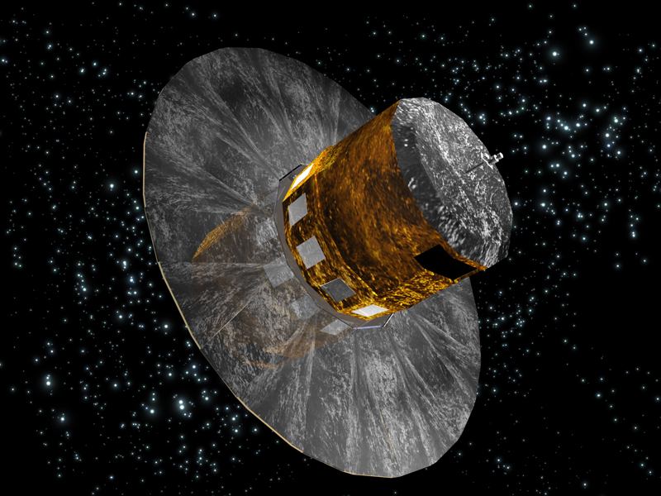
GAIA performance
Gaia is launched successfully 19 Dec. 2013
Three issues:
Brightness calculation, now mitigated
H₂O condensation on one primary, now mitigated
Stray light, not yet mitigated, will make at least one more attempt
Notional Intermediate catalog L+22m (pos), L+28m (5 parameters)
Final Gaia catalog may replace VLBI catalog as ICRF, but stray light problem???
Simulated Gaia errors do not yet model stray light problem
which Gaia is having at weak end (near 20th mag).
Do not model the effect of color (V-I) magnitude.
Took into account model Gaia's ecliptic latitude variations in precision.

Slide 27
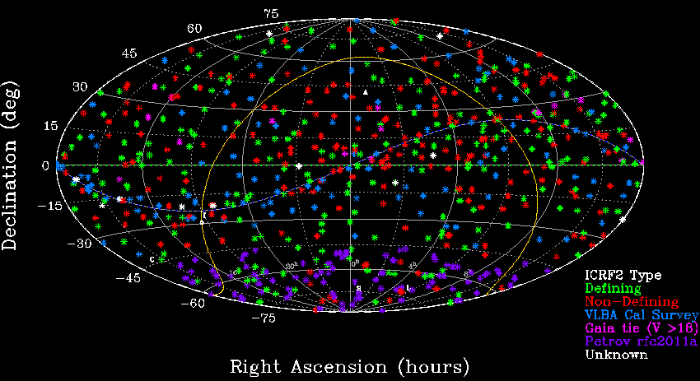
ICRF2 type for 654 XKa sources
South polar cap (Dec -45 to -90): 27 ICRF-2 defining sources
2/3 non-ICRF2 sources
GAIA tie sources detected in X/Ka:18 detections mostly in NH!

Slide 28
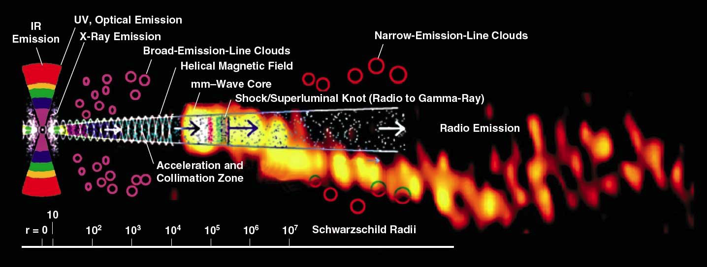
Emission zones in relativistic jets
R~0.1-1 µas 1mas
Credit: A. Marscher, Proc. Sci., Italy, 2006.
Overlay image: Krichbaum, et al, IRAM, 1999.
Montage: Wehrle et al, ASTRO-2010, no. 310.
Talk here about emission correlation between different wavelengths → co-spatial emission or not (delays and variability)
optical/gamma for 3C279 (Abdo, Nature, 2011)
Radio/gamma Fuhrmann MNRAS 2014
Notes:
Features of AGN: Note the Logarithmic length scale.
“Shock waves are frequency stratified, with highest synchrotron frequencies emitted only close to the shock front where electrons are energized. The part of the jet interior to the mm-wave core is opaque at cm wavelengths. At this point, it is not clear whether substantial emission occurs between the base of the jet and the mm-wave core.”
Credit: Alan Marscher, `Relativistic Jets in Active Galactic Nuclei and their relationship to the Central Engine,’
Proc. of Science,VI Microquasar Workshop: Microquasars & Beyond, Societa del Casino, Como, Italy, 18-22 Sep 2006. Overlay (not to scale): 3 mm radio image of the blazar 3C454.3 (Krichbaum et al. 1999)

